Slide 1


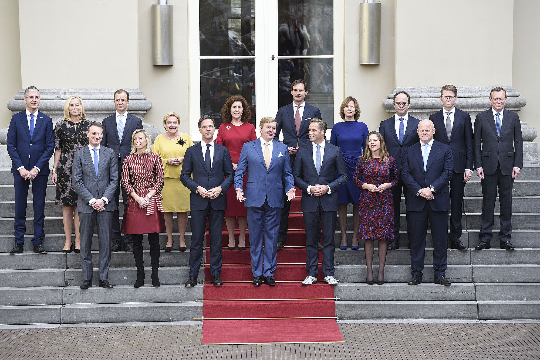

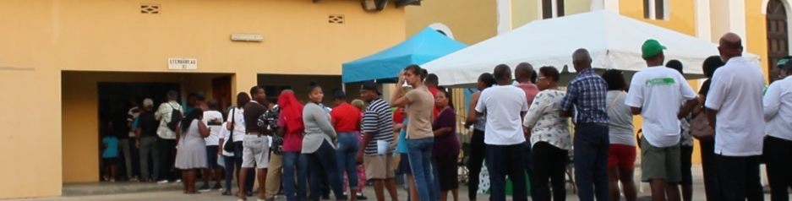
Power within the public entity
?
APPOINTS
Governor
Government
(Monarch and ministers)
?
?
Commissioners
KIEZEN
DECISION
PROPOSAL
?
Council Island
KIEZEN
?
Voters
(citizens)
Notes:
1

